Slide 1
Incident Response Plan

Slide 2


Objectives
Introduction and Overview
Review Incident Response Template
Discuss what steps organizations should take to enhance or develop IRP plan

Slide 3


Agenda
Overview of Toolkit
Incident Response Plan
Template Review
Questions
Conclusion
Supporting Documentation

Slide 4


Toolkit Template Overview

Slide 5

The objective of these templates is to provide guidelines and recommendations for the formulation, development and review of policies procedures. This document is a supplement to the current emergency policies. These recommendations and guidelines should be viewed as providing general direction, rather than specific prescriptions for action, unless specific actions are required by existing policies or regulations.
What is a
Template
Purpose and
Function ?
Notes:
Templates Provide
a. Guidelines
b. Recommendations
This is a supplement to your current plans to provide general direction
I don’t know your exact environment - so the idea here is the template need to be adapted to what makes business since to your organization

Slide 6

Incident Response Template
HIPAA §164.308(a)(6)(I) Standard - Security Incident Procedures (Required)
Implement policies and procedures to address security incidents.
This standard requires a covered entity or a business associate to develop a plan for handling security incidents and breaches. The resulting policies and procedures should cover all potential categories of incidents and breaches. Including:
1. Policy violations by users,
2. Known incidents like denial-of-service attacks, Phishing and Ransomware
3. Intrusions, and unauthorized disclosures.
4. Contact lists
5. Incident documentation
This standard includes one related mandatory implementation specifications, “Response and Reporting Procedures.” Implementation Specification §164.308(a)
The Security Incident Response Template Master
This is an organized approach to addressing and managing the aftermath of an IT security breach, computer incident or security incident. The goal is to handle the situation in a way that limits damage and reduces recovery time and costs. Incident response activities are conducted by an organization's computer security incident response team (CSIRT), a group that has been previously selected to include information security and general IT staff as well as C-suite level members.
Notes:
Incidents Response Plans are Required by HIPAA

Slide 7
Templates
Security Incident Response Template Master------------------------------------------Main Tool
IRP Recovery Team Procedures Template
Security Breach Tracking Form Template
Security Incident Intake Form Template
Security Incident Tracking Form Template
Employee Termination-Checklist Template
Notes:
Review Tool -- Open Template (( Lets Review The Tool ))

Slide 8


Security Incident Response
Components of a Security Incident Response Plan Checklist
Business Units/Locations with primary and backup contact names and numbers
Critical Hardware List
Business Risk Assessment (What is most Important)
CIRT Team Members and Responsibilities (RACI Chart)
Defines What and Incident is
Communications and Coordination Plans
Insurance
Call lists
Critical Vendor, Service Provider, and Law Enforcement contact information
Security Incident Handling Procedures
Known Threats Procedures
Escalation Procedures and Security Incident Notification Plans
Training Plan (IRP)
Security Training (Current Threats)
Breach Notification Information
Chain of Custody Procedures
Post Incident Activities (Return to Normal Business)
Learned Lessons
Notes:
Templates, Tools, and Assistance will be available from CHCANYS

Slide 9

Security Incident Response
9
Test Incident Response Plan through Tabletop Exercises
Test likely scenarios (e.g. Ransomware, Phishing, Theft)
Develop Plans for Known Threats
Improve based on lessons learned
Maintenance
Review documentation of security incidents to identify improvements
Don’t Collect Dust/ Update/Review annually

Slide 10
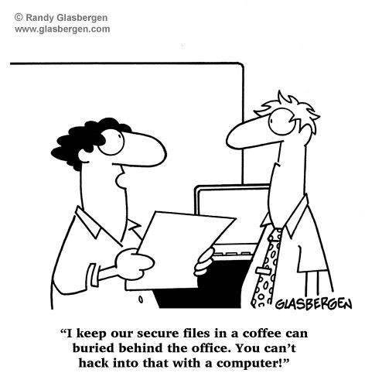
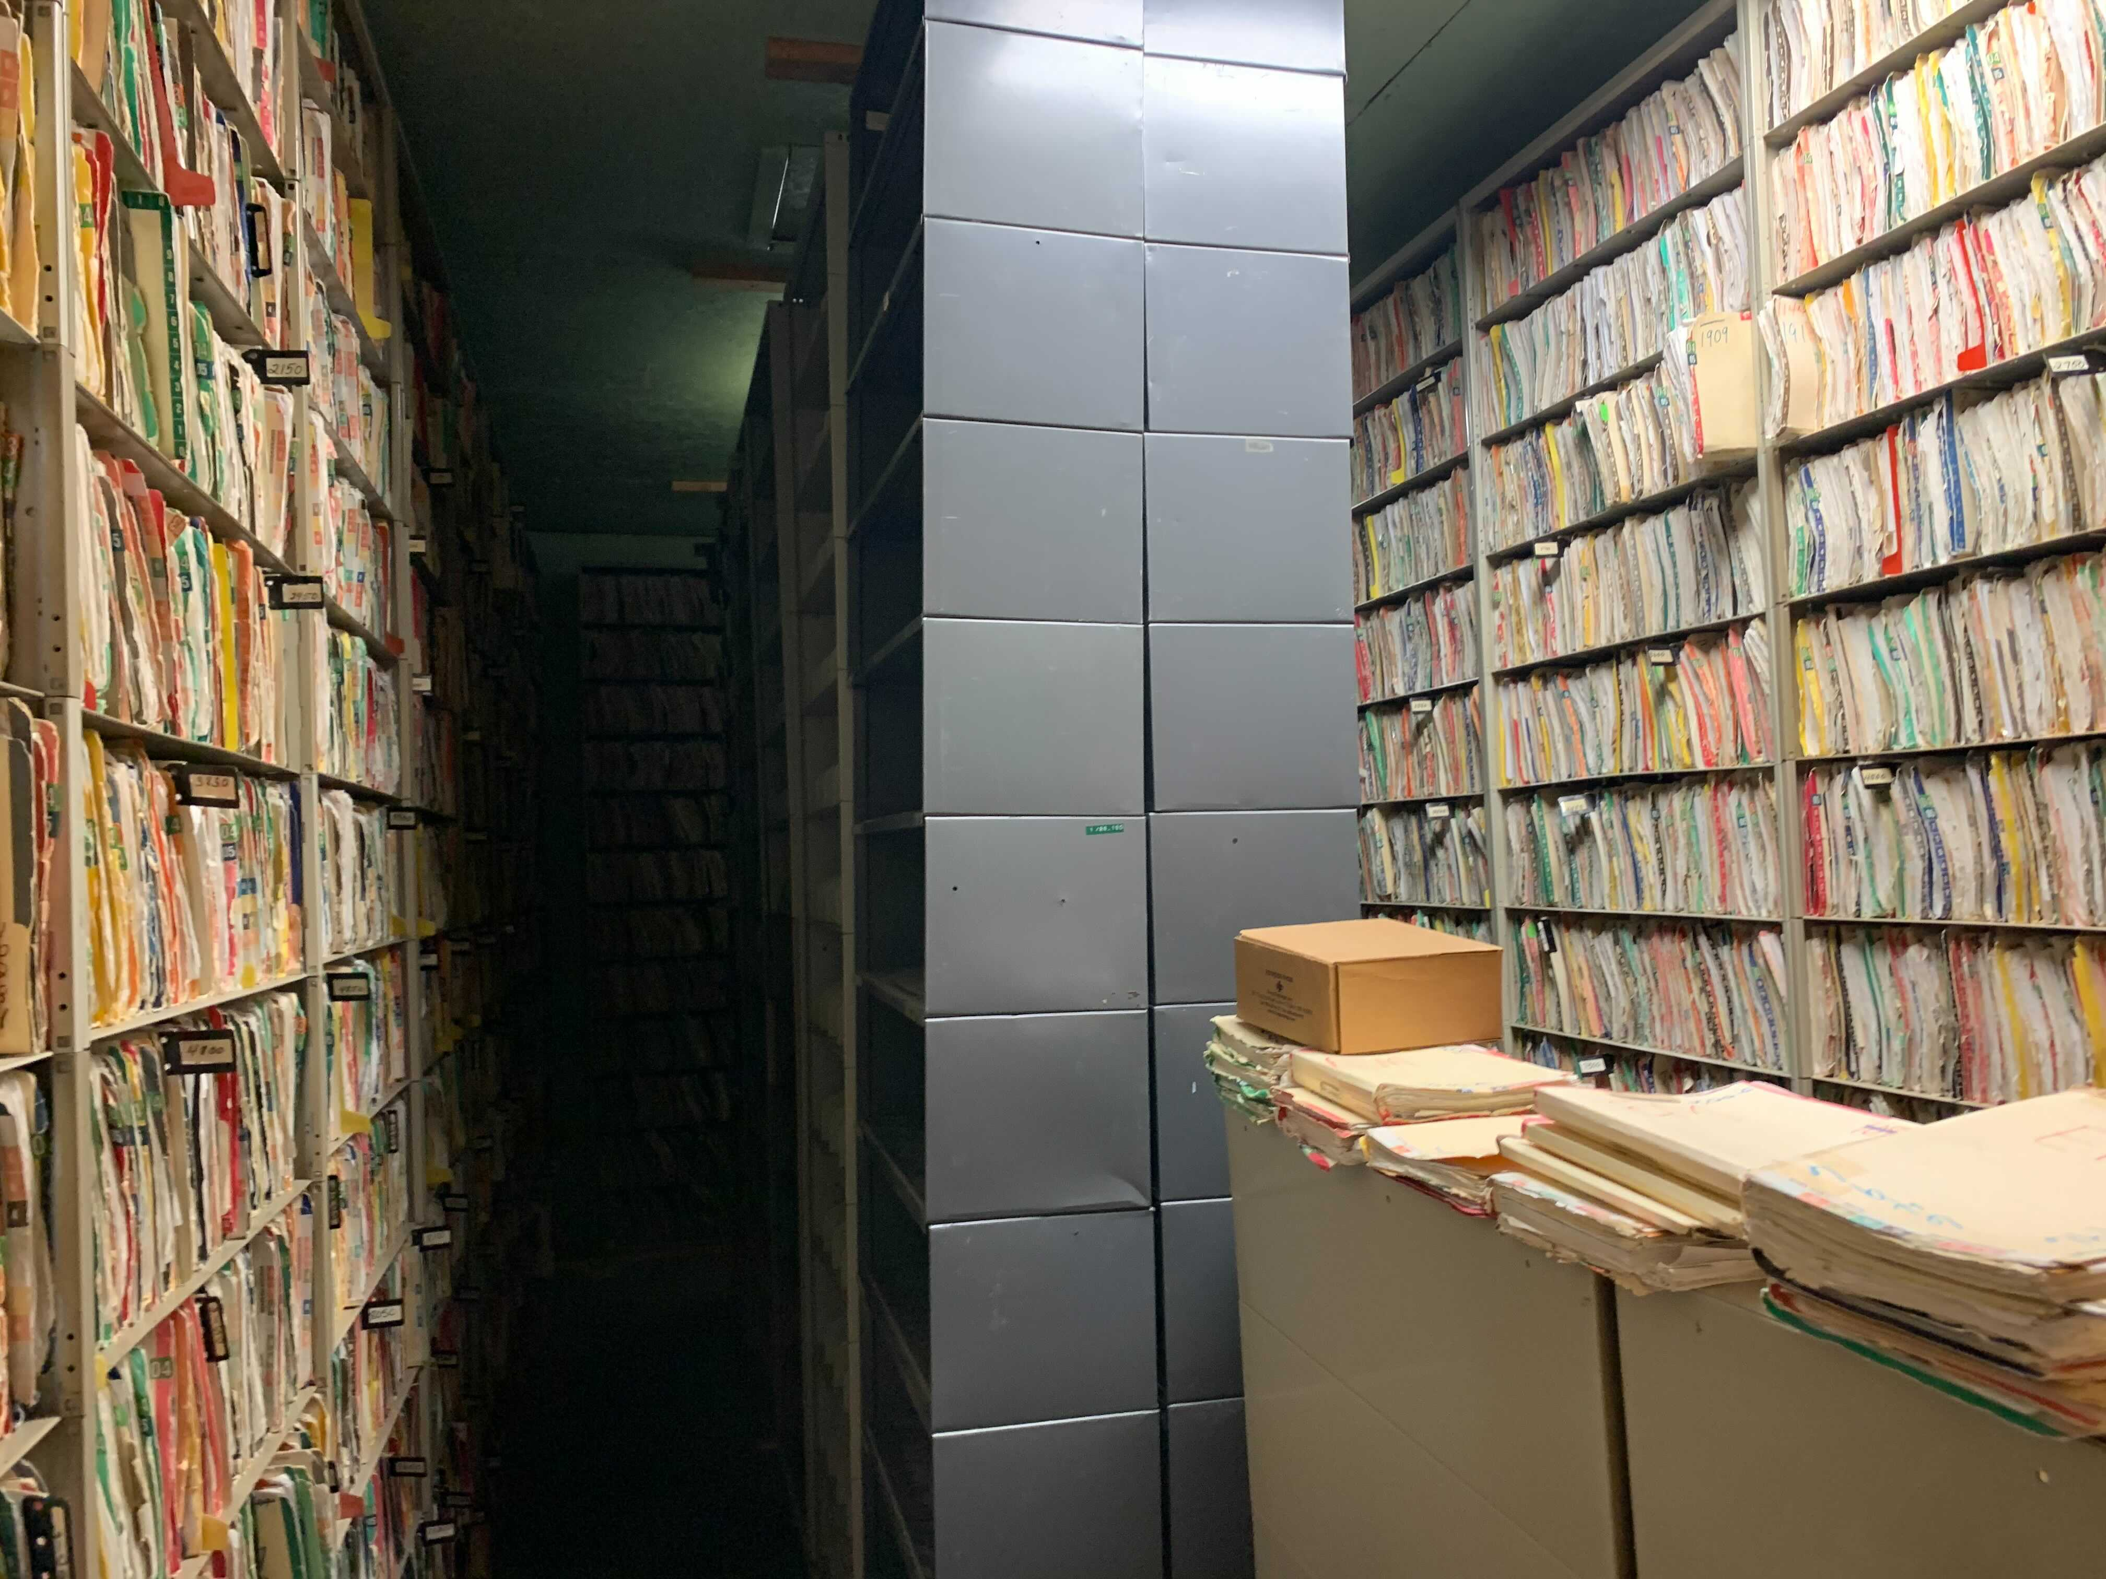
Ransomware Guidance :

Slide 11
Security Measures
Awareness
User Interface
Security incident process
Awareness emails
Targeted campaigns
Monthly newsletters
Labs and direct training
Incentives
Third Party Training (KnowBe4)
Phishing Training
https://phishinsight.trendmicro.com/en/
.
Lock down desktop settings
USB drives locked
SPAM filters
Only Application needed for business
Stricter install
File and computer inspections
Limit EMR time access
Enhance MFA for EMR on remote accounts
01
02
User Interface
.
Awareness
Ransomware
Monitoring
Perimeter
Firewall perimeter alerts
Enable IPS on firewalls
Operations Center – central interface with key systems and alerts
Back-up & Restore process
3rd party security monitoring
Monitor outgoing traffic
.
Monitoring
Reduce external connections
VPN / VDI / MFA
3rd party connections
SPAM filtering
DDOS readiness
Real-time EPP and IDS / IPS
File integrity monitoring
.
Perimeter
04
03

Slide 12
Technical Guidance
Monitoring
Detection
Communication/
Network
Access Control
Emergency
Management
Implement IDS systems
Monitor inbound and outbound data
Virus protection
Third party network testing
Activity monitoring
File access monitoring
SOC Monitoring
Real-time EPP and IDS / IPS
But don’t completely rely on technology (SolarWinds)
Email encryption and filtering (Mimecast, Barracuda)
Fax directly to EMR system
Network segmentation (Cloud)
E3 Microsoft Security
Third-Party EMR system
Configuration Management
MFA for all external connection that access ePHI and critical processes
Review third party accounts to make sure old accounts are not active
Internal account review
BCP and IRP should have a specific plan for Ransomware
Contact cyber insurance company first to address forensics and chain-of-custody
Have a chain-of-custody plan
Have routine test of backups and restoring backups and critical operations

Slide 13



Thank You
Please Fill Out the Quick Evaluation
Please Fill Out the Quick Evaluation

Slide 14
References
NIST 800-61 – Computer Security Incident Handling Guide - https://nvlpubs.nist.gov/nistpubs/SpecialPublications/NIST.SP.800-61r2.pdf
NIST 800-84 - Guide to Test, Training, and Exercise Programs for IT Plans and Capabilities - https://csrc.nist.gov/publications/detail/sp/800-84/final
https://www.fema.gov/media-library/assets/documents/26845
https://security.berkeley.edu/faq/ransomware/

